Slide 2
Background
Public Library Systems in America as a whole account for one of the largest exchanges of published material in the world
The Seattle Public Library System is the 17th most visited in the US (excluding University Libraries) with over 5.4 million visits per year¹ and possess a collection of over 2.3 million items².
Serves a population of approximately 686,800, with over 378,000 members².

Slide 3
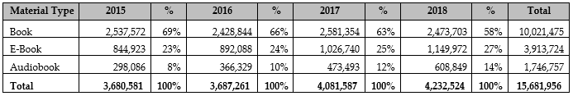
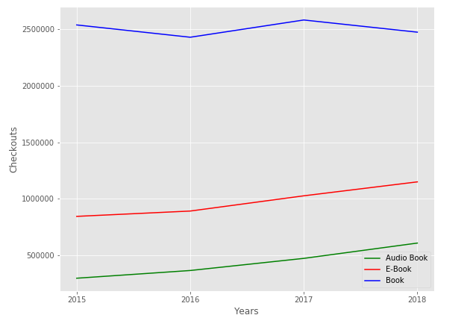
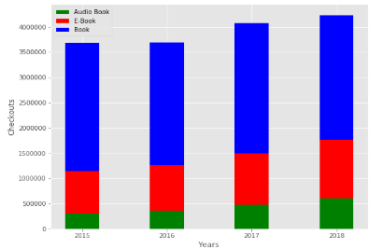
In what format are people consuming material and how is it changing over time?
Checkouts By Material Type and Year

Slide 4
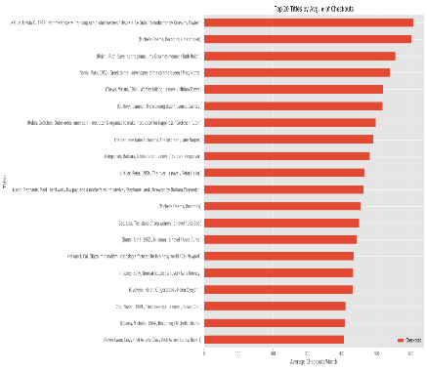
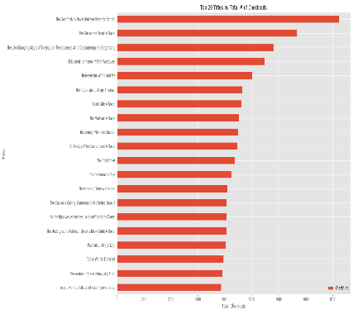
What are the Most Popular and Top Checked out Titles?

Slide 5
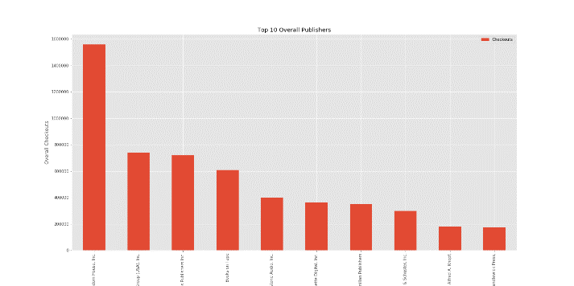
Who are the top 10 publishers?

Slide 6
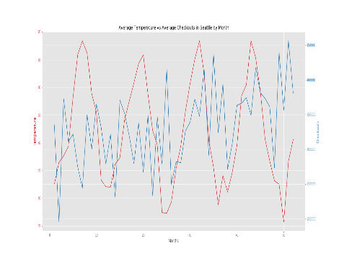
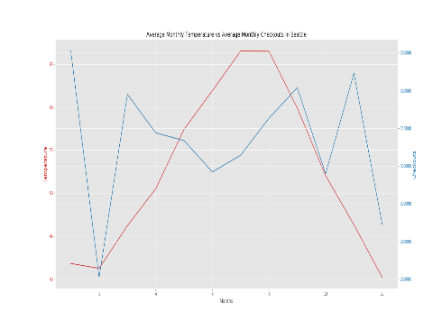
Is there a correlation between weather and checkouts?

Slide 7
References
"2016 Washington Public Library Statistical Report" (PDF). Washington State Library. October 2017. Retrieved 05, July 2019.
“Seatle Public Library.” Wikipedia: The Free Encyclopedia. Wikipedia, The Free Encyclopedia, 11, June 2019. Web. 05, July 2019,https://en.wikipedia.org/wiki/Seattle_Public_Library

